Slide 1
Risk Management Lessons from Long-Term Capital Management
Speaker : Yichen Liu

Slide 2
Content
Part 1
1. History of LTCM
Part 2
2. VAR and equity capital
Part 3
3. LTCM’s risk management story
Part 4
4. Portfolio optimization and story
Part 5
5. LTCM’s risk profile
Part 6
6. Conclusion

Slide 3
01
History of LTCM

Slide 4
History
In 1994, LTCM was founded by Meriwether
Meriwether took with him a group of traders and academics, who had been part of Salomon's bond-arbitrage group. Together, they set up a 'hedge' fund using similar principles at Salomon.

Slide 5
Core Strategy
of LTCM
Relative-value', or ‘Convergence-arbitrage' trades--→ take advantage of small differences in prices among closely related securities.
For instance, an off-the-run Treasury bond yielding 6.1% versus 6.0% for the more recently issued on-the-run. The yield spread represents some compensation for liquidity risk.
The key is that eventually the two bonds must converge to the same value.

Slide 6
Problem
To generate high profits, use leverage
To control risk, the target ceiling risk level was set to the volatility of an unleveraged position in US equities.
In essence, positions were obtained by an optimization with a constraint on volatility. Thus, leverage had to be quite large

Slide 7
Profitable
1997, Capital grew from $1 billion to more than $7 billion. The firm was charging lofty fees is 2% of capital plus 25% of profits. (Higher than other hedge funds)
LTCM's 16 partners had invested roughly $1.9 billion of their own money in the fund.
LTCM's balance sheet was about $125 billion----→total assets -----→equity $5 billion only-----→astonishing leverage ratio 25:1--→most of it borrowed.
Even more astonishing ----- the off-balance-sheet position, including swaps, options, and other derivatives-----$1.25 trillion

Slide 8
Profitable
LTCM was able to leverage its balance sheet through sale-repurchase agreements with commercial and investment banks.
(Under repo agreement, with next-to-zero haircuts, as it was viewed as 'safe' by its lenders. )
Trouble

Slide 9
Profitable
LTCM was able to protect its short-term repo positions with term financing (e.g. 6 months) from Wall Street that carried no initial margin.
LTCM also secured a $900 million credit line from Chase Manhattan and other banks.
On the asset side, LTCM was also 'bulletproofing' against a liquidity squeeze. Required investors to keep their money in the fund for a minimum of 3 years, was to avoid forced sales in case of poor performance.

Slide 10
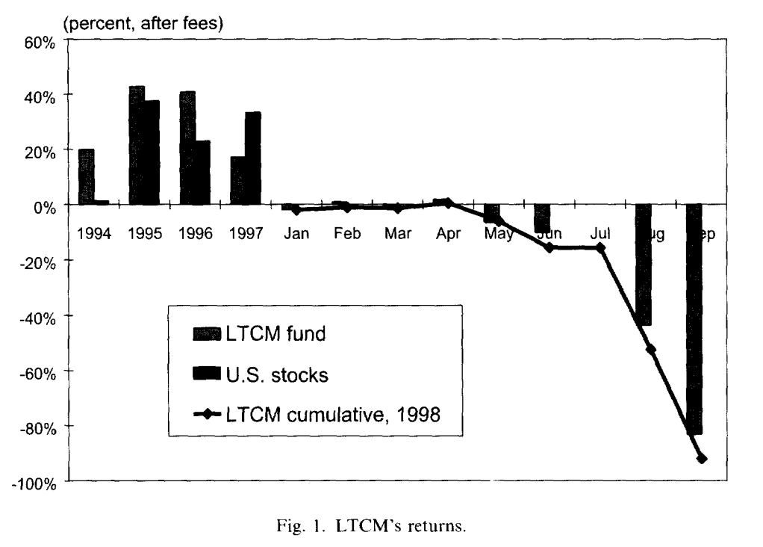
Strategy
performance
This strategy worked excellently in 1995 and 1996
after-fees returns above 40%

Slide 11
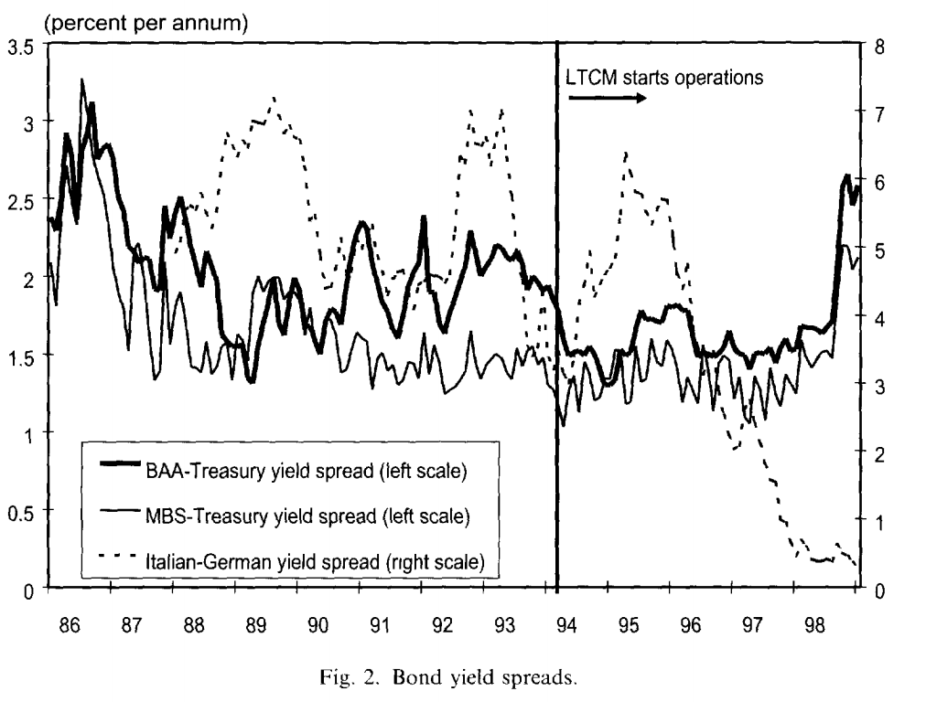
Strategy
performance
The evolution of relevant yield
spreads since 1986.
As the figure indicates, credit spreads were almost as narrow as they had ever been since 1986 and considerably lower than the average over the period 1986-93. -------meant convergence trades --------had become less profitable.

Slide 12
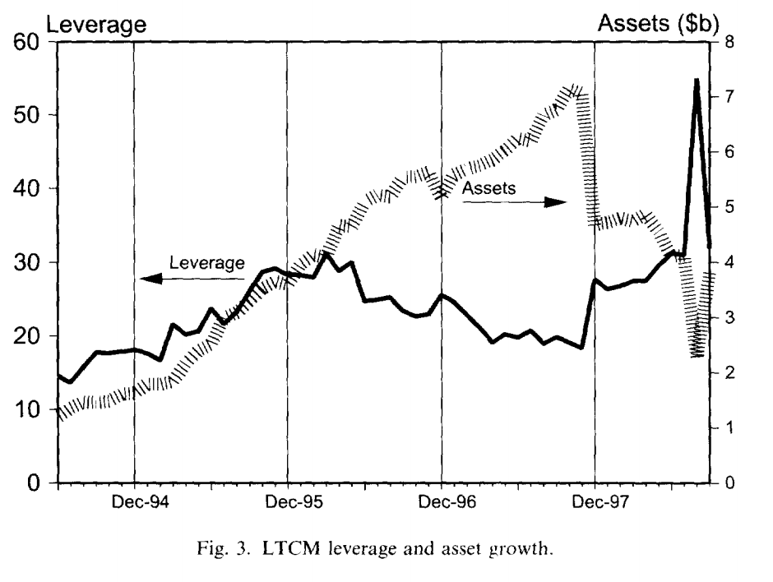
Strategy
performance
The leverage decreased from
25 to 18 due to the asset growth.
To achieve the 40% returns,
the firm had to assume
greater leverage.
So, LTCM returned capital to
investors in 1997
By shrinking the capital base to $4.7 billion---the leverage ratio went back up to 28-------amplifying returns to investors that remained in the fund, as shown in Figure 3.

Slide 13
Trouble
Increased the risks. Troubles began
1. May and June of 1998. A downturn in the mortgage-backed securities market led to a 16% loss in LTCM's capital, which dropped from $4.7 to $4.0 billion --------increasing leverage from 28 to 31.
2. August 17. Russia announced defaulting on its debt. --------led to a reassessment of credit and sovereign risks across all financial markets.
3. August 21. LTCM lost $550 million alone

Slide 14
Trouble
4. By August, the fund had lost 52% of its 31 December value. With assets still at $126 billion, the leverage ratio had increased from 28 to 55:1. LTCM badly needed new capital. But no one interest in investing
5. September 21, the fund lost another $550 million, mostly due to increased volatility in equity markets. Bear Stearns, LTCM's prime broker, faced a large margin call from a losing LTCM T-bond futures position. It then required increased collateral, which depleted the funds's liquid resources.
Counterparties feared that LTCM could not meet further margin calls, in which case they would have to liquidate their repo collateral.

Slide 15
Trouble
6. A liquidation of the fund would have forced dealers to sell off tens of billions of dollars of securities and to cover their numerous derivatives trades with LTCM.
7. New York Federal Reserve felt compelled to act. On 23 September, encouraging 14 banks to invest $3.6 billion in return for a 90% stake in the firm.

Slide 16
Trouble
8. By 28 September, the fund's value had dropped to $400 million only.
9. September was even worse, with a loss of 83%. Investors had lost a whopping 92% of their year-to-date investment.
10. After the rescue, LTCM operated under the control of the 14-member consortium, formally known as Oversight Partners I LLC. Helped by recovering financial markets, the portfolio gained 13% to December 1998. The portfolio was unwound over the following months.

Slide 17
02
VAR and equity capital

Slide 18
VAR
Value at Risk (VAR) has been heavily blamed for LTCM's failure.
But we all know, VAR is a key component of capital adequacy measures for commercial banks and is spreading fast to other users. Indeed, banks now have the option to use their own VAR risk management model as the basis for required capital ratios.

Slide 19
VAR
If, however, VAR is used as the basis for setting the amount of equity capital, the parameters must be chosen with extreme care. The confidence level must be high enough that the probability of exceeding VAR is very low.
Indeed, by the end of August, LTCM had $2.3 billion of equity capital and $1 billion excess liquidity. The firm could either reduce risk or raise fresh capital. Due to the enormous size of its positions, it could not cut its risk exposure fast enough. Similarly, it was unable to attract new investors. As the markets continued to slide in September, it became clear that the firm had grossly underestimated its capital needs.

Slide 20
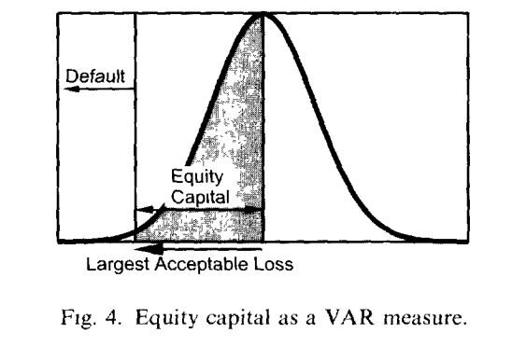
VAR
As before, VAR is interpreted as the 'largest' acceptable loss the bank is willing to suffer over a specified period. To cover this loss, the bank must maintain adequate equity capital. In other words, VAR is the amount of capital a firm allocates to self-insurance. This is illustrated in Figure 4.

Slide 21
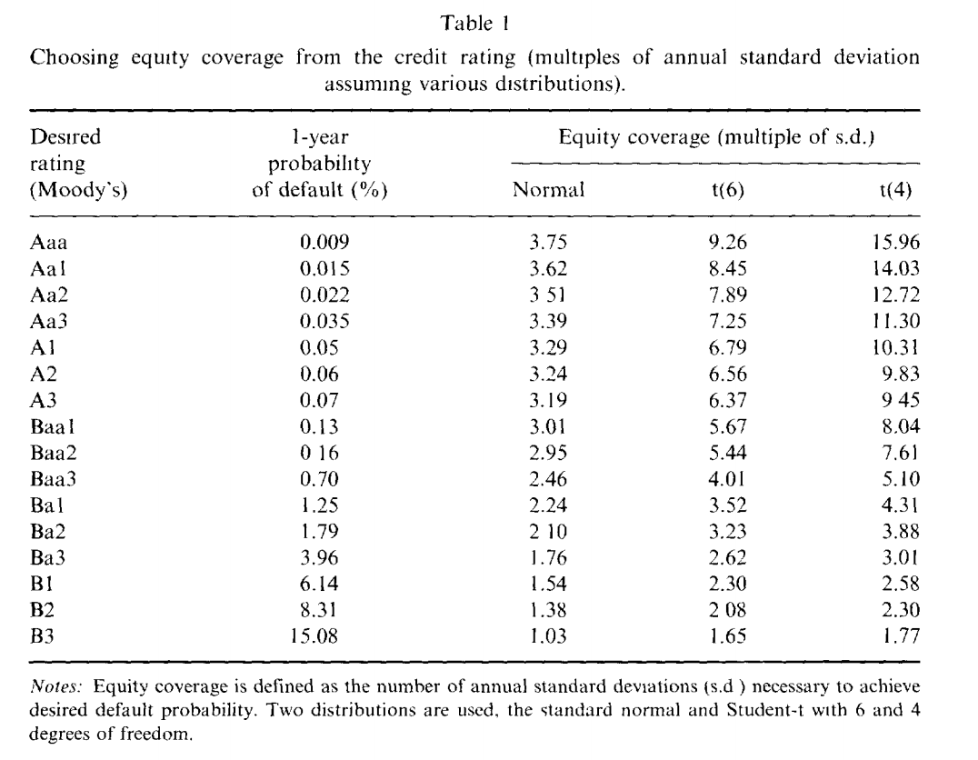
VAR

Slide 22
03
LTCM’s risk management story

Slide 23
volatility
the portfolio was managed-------- its target risk was no larger than the risk of an unleveraged position in the S&P 500
How did the VAR apply to the LTCM story? The $1.2 trillion notional amount, or even $125 billion in assets, is meaningless. What mattered was the overall volatility of the fund. LTCM aimed for a level of risk no greater than that of US equities.
The annual average volatility of the S&P 500 over 1978-97 was 15%. Applying this number to $4.7 billion, we find a daily dollar volatility of $4,700 0.15/252 = $44 million. It was claimed that the portfolio was no more risky than an unleveraged investment in equities

Slide 24
volatility
Indeed, LTCM stated that its target daily volatility was $45 million around May 1998. In other words, the positions were allocated to maximize expected returns subject to the constraint that the fund's perceived risk was no greater than that of the stock market.
LTCM was maximizing returns while closely monitoring its volatility.

Slide 25
volatility
The $45 million number, It assumes that volatility is constant, when in fact it can easily double in turbulent times.
Even if the distributions were symmetrical, it is unlikely their tails could be well described by a normal distribution.

Slide 26
Major mistake
The firm reportedly tried to reduce its risk, but made a major mistake:
instead of selling off less-liquid positions, or raising fresh capital, it eliminated its most liquid investments because they were less profitable.
This made LTCM more vulnerable to subsequent margin calls.

Slide 27
volatility
After this adjustment, LTCM's models indicated that its daily volatility should have been indeed reduced to $35 million.
Something was wrong, however. Its actual daily volatility was closer to $100 million.
Either the market were getting more volatile or the models were seriously biased. Probably both.

Slide 28
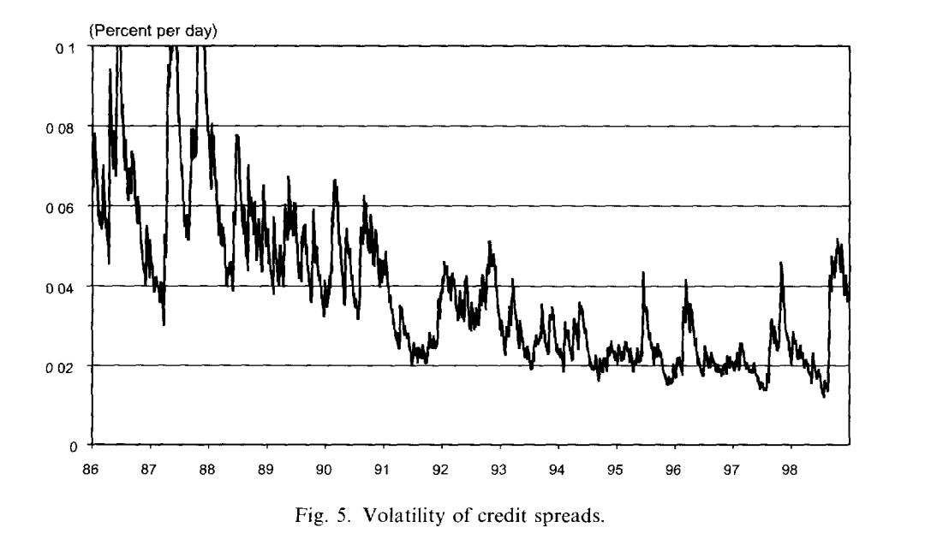
Volatility in
credit spreads
Figure 5 shows the predictable of the daily volatility of changes in credit spreads.
The forecast is based on exponential weighing
shows that, first, the average volatility over 1995-97 was low by historical standards.
Second, volatility creeps up on 25 August from 0.019 to 0.027; on 27 August, it moves and stays above 0.04, double its recent value. Thus standard risk management methods would have picked up the increase in market volatility.

Slide 29
Result
On 21 August, the portfolio lost $550 million.
By 31 August, the portfolio had lost $1,710 million in 1 month only. Using the presumed $45 million daily standard deviation, Surely this assumption was wrong.

Slide 30
Two mistakes
1. LTCM relied on recent history to estimate risk, assigning a low probability to events such as sovereign defaults and major market disruptions such as the 1987 crash, which also led to a flight to liquidity. Since credit-sensitive instruments are by nature affected by rare events, this approach missed the true risks of the portfolio.
2. LTCM is also reported to have done stress-testing of its portfolio. The firm had stress loss predictions that it could lose $2.3 billion in a worst-case scenario. In fact, it lost $4.4 billion during 1998. It also failed to appreciate that its very size made it impossible to manoeuver once it had lost $2.3 billion.

Slide 31
More fundamentally, the firm had badly underestimated its risk and did not have enough long-term capital to ride out the turbulence of 1998.

Slide 32
04
Portfolio optimization and story

Slide 33
Formula
If there is a portfolio optimization with two highly correlated assets.
Assume the investor seeks to maximize a utility function
The optimal positions in risky assets are given by

Slide 34
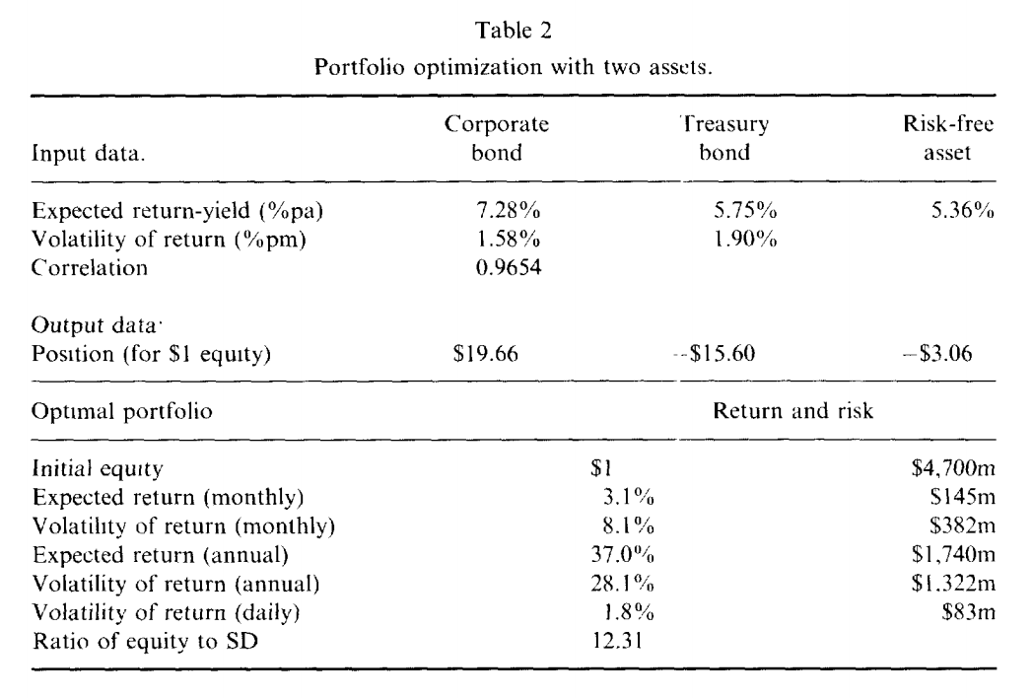
example

Slide 35
Problem
The problem is the presumed risk of the strategy.

Slide 36
Problem
There are two problems with this：
The first is the combined effect of portfolio optimization with estimation error.
If the number happens to be high because of (positive) estimation error, the optimizer will tend to take large opposite positions in the two assets to exploit this illusory safety.
The estimated correlation will be randomly distributed around the true value and any error will be amplified by the optimization.

Slide 37
Problem
The second problem is that the true correlation may change over time. If we start with a very high correlation, there is probably more chance that it will drop rather than increase.

Slide 38
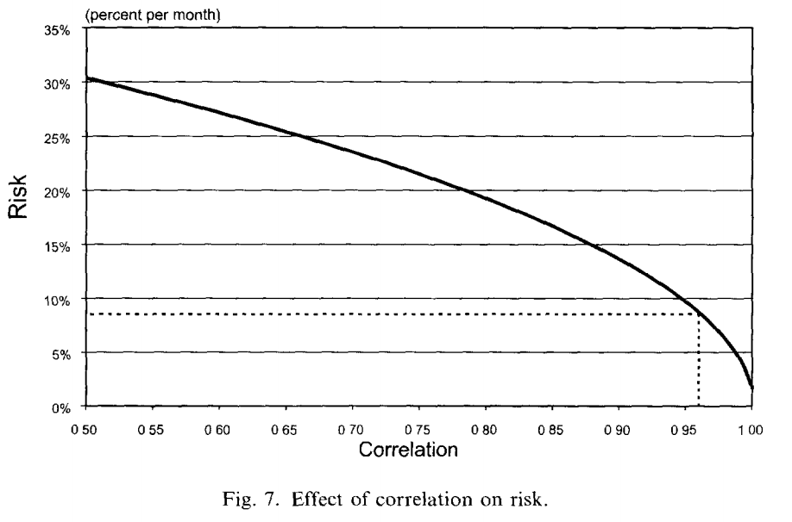
Stress-testing
This is why we need stress-testing, which involves changing the parameters to assess the sensitivity of the results. Figure 7 examines the volatility of the current optimized portfolio as the correlation coefficient decreases.

Slide 39
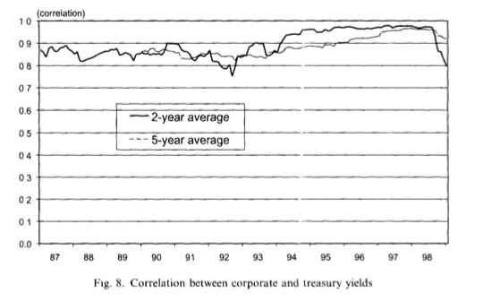
What actually happened to this correlation is described in Figure 8.

Slide 40
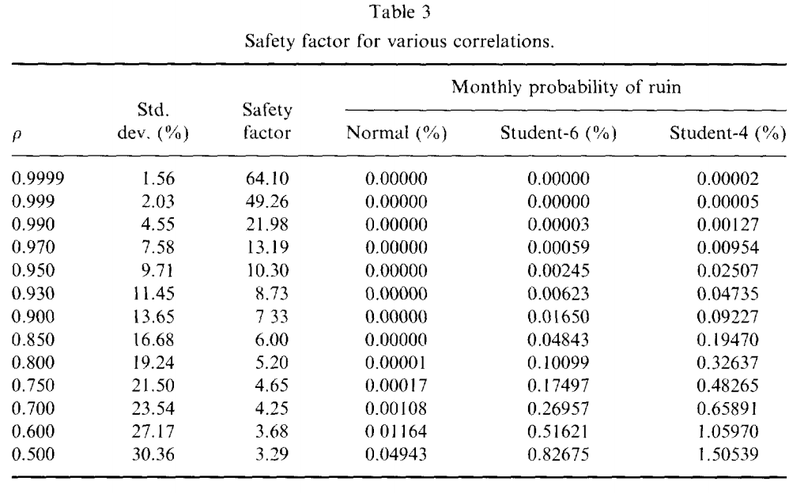
The problem is that as soon as the correlation drops to 0.80, the safety ratio decreases to 5.2. With a normal distribution, With a Student t(4), however, the odds move to 1 month out of 306, or one year out of 26. Now the odds of failure are not so remote.

Slide 41
Estimation risk increases with the number of parameters. The more parameters are estimated, the greater the chance that errors will interact with each other and create a misleading picture of risk.
One cannot rely on the same covariance matrix to perform the portfolio optimization and to measure risk.

Slide 42
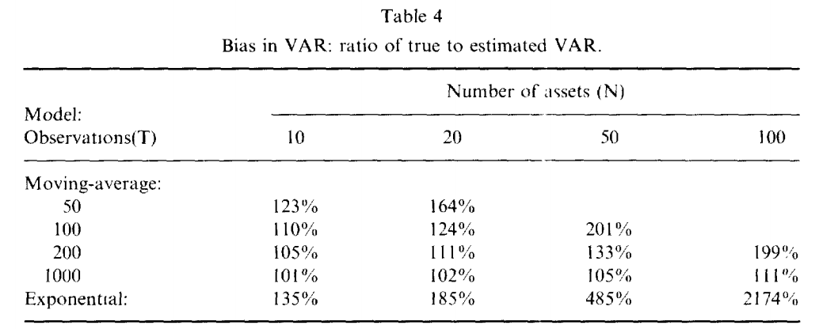
A similar problem occurs when traders try to 'game' a VAR system.
Table 4 shows that the bias can be quite substantial. With 50 assets, the true VAR is nearly 5 times the estimated VAR.

Slide 43
05
LTCM’s risk profile

Slide 44
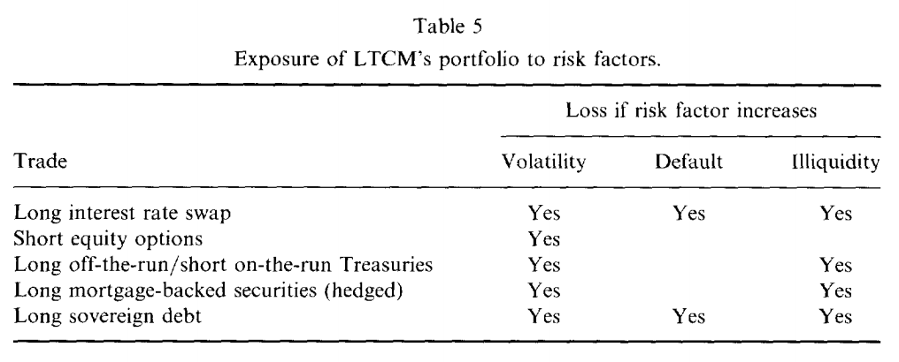
LTCM failed because of its inability to measure and manage its risk. This was due to the fact that LTCM's trades were rather undiversified.
Table 5 describes the exposure of various reported trades to fundamental risk factors. All the trades were exposed to increased market volatility. Most were exposed to liquidity risk (which is correlated with volatility). Many were exposed to default risk.

Slide 45
LTCM is a good example of the biases in portfolio optimization. Only a few of the 'convergence' trades could truly qualify as arbitrage trades.
One example is the long position in the off-the-run bond offset by a short position in the on-the-run equivalent.
In this case, the probability of default is identical and eventually, the two bonds will converge to the same value
In the meantime, though, the spread could widen further, thus requiring the fund to carry enough capital to absorb temporary losses.

Slide 46
the LTCM portfolio was also exposed to liquidity risk, which causes losses when volatility increases.
LTCM liked to compare itself to a Wall Street investment bank, like Salomon Brothers, which was leveraged by the same amount, about 25 times. This comparison is faulty for a number of reasons. First, bank portfolios are more diversified. They deal with fixed income markets, currencies, equities, and commodities.
Second, brokers' trading activities actually benefit from increased volatility, as volatile markets generate greater trading volume and revenues.
Finally, investment banks can have access to fresh funds much faster than any hedge fund.

Slide 47
06
Conclusion

Slide 48
1.severely underestimated its risk
2.maximizing expected returns subject to a constraint on VAR created huge leverage and extreme sensitivity to instability in the correlations. We have also learned the danger of building measures of event risk based on very recent price data.
3. Make better use of stress-testing, looking at worst-case scenarios for the portfolio at hand.
4. convergence-arbitrage strategy induced the fund to make undiversified and
highly leveraged bets on more subtle risks such as credit risks, political risks,
or market disruptions. dangerous and much riskier than measured by traditional
risk management systems.

